Slide 1

01
Data Processing
02
DeepFM
CONTENTS
03
Feature Selection
04
Module Tuning
05
Result

Slide 2

Training Set, Validation Set and Test Set
Attributes | Training Set | Validation Set | Test Set | Validation Set & Training Set | Test Set & Training Set
AdID | 631849 | 355071 | 300012 | 355071 | 269995
AdvertiserID | 14842 | 14486 | 11157 | 14486 | 10753
QueryID | 23295643 | 4950152 | 3801978 | 4950152 | 1660789
KeywordID | 1161369 | 521682 | 495421 | 521682 | 431313
TitleId | 3626120 | 1315048 | 1262498 | 1315048 | 937550
Description | 2848249 | 1046266 | 981985 | 1046266 | 737008
UserID | 21473870 | 6422303 | 3263681 | 6422303 | 1364217

Slide 3
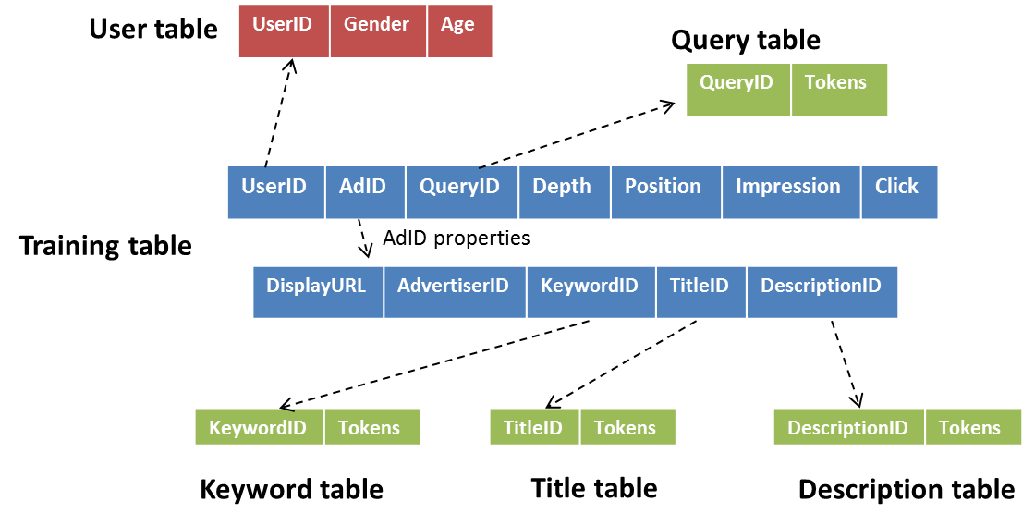
Feature Construction

Slide 4
Features Generating
CTR | DisplayURL | AdID | AdvertiseID | Depth | Position | QueryID
KeywordID | TitleID | UserID | DescriptionID | Gender | Age | RelativePosition
group_Query | group_Keyword | group_Title | group_Description | group_User
aCTR_Ad | aCTR_Advertiser | aCTR_Depth | aCTR_Position | aCTR_RPosition
pCTR_Url | pCTR_Ad | pCTR_Advertiser | pCTR_Query | pCTR_Keyword | pCTR_Title
pCTR_User | pCTR_Gender | pCTR_Description | pCTR_Age | pCTR_RPosition

Slide 5
Features Generating
num_Depth | num_Position | num_RPosition
num_Imp_Depth | num_Imp_Ad | num_Imp_Position | num_Imp_RPosition
num_Query | num_Keyword | num_Title | num_Description
sparse_Url | sparse_Ad | sparse_Advertiser | sparse_Query | sparse_Keyword | sparse_Title
sparse_User | sparse_Gender | sparse_Description | sparse_Age | sparse_RPosition

Slide 6
Procedure
1. python feature_statistic.py # get the statistics from original data
2. python features_min_max.py # for normalizing dense features
3. python construct_mapping_fn.py #for one-hot encoding
4. python count_features_fn.py
5. python tokens_vector.py # compute the IDF of each tokens
6. python sum_idf.py
7. python construct_tokens_vectors.py
8. python shuffle_big_file.py or python shuffle_file_enough_memory.py
9. python combine_data.py train/test
10. python divide_data_to_train_valid.py
Notes:
# get the statistics from original data
python feature_statistic.py
# get the min and max value for normalizing dense features
python features_min_max.py
# construct the mapping for one-hot encoding
python construct_mapping_fn.py
# compute the dimension of sparse features
python count_features_fn.py
# compute the IDF of each token
python tokens_vector.py
# get the sum of IDF for each token
python sum_idf.py
# construct the vector to represent each token
python construct_tokens_vectors.py

Slide 7
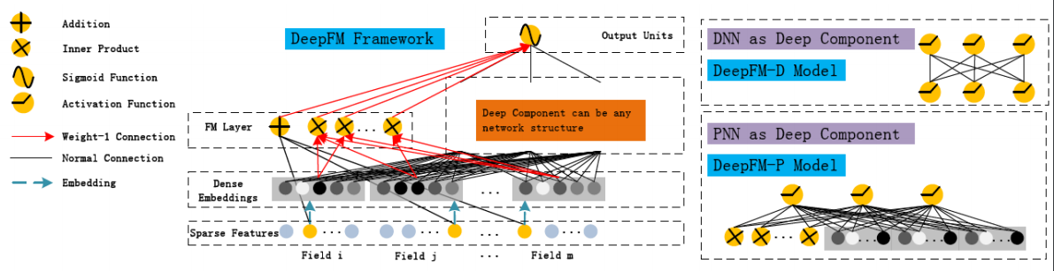
DeepFM

Slide 8
Features Selection
Features | AUC
Sparse | －
Add pCTR | ↑
Add aCTR | －
Add Group | ↑
Add num_tokens | ↑
Add age, depth, position, rposition | ↑
Add num_impression | ↓
Add num_occurs | ↑
Add sum_idf | －
Add tokens_vector | ↑
Add ID_val | －
Add mean_idf | －
Notes:
# get the statistics from original data
python feature_statistic.py
# get the min and max value for normalizing dense features
python features_min_max.py
# construct the mapping for one-hot encoding
python construct_mapping_fn.py
# compute the dimension of sparse features
python count_features_fn.py
# compute the IDF of each token
python tokens_vector.py
# get the sum of IDF for each token
python sum_idf.py
# construct the vector to represent each token
python construct_tokens_vectors.py

Slide 9
Model Tuning
Hidden Size | AUC
[128, 128] | －
[512, 256] | ↑
[512, 256, 128] | ↑↑
[512, 256, 256, 256, 128] | ↑↑
Batch Size | AUC
6000 | －
10000 | ↑
15000 | ↑↑
18000 | ↑↑↑
30000 | ↑↑↑
Keep Prob | AUC
1 | －
0.9 | ↓
0.8 | ↓
Embedding Size | AUC
8 | －
20 | ↑
25 | ↑↑
Notes:
# get the statistics from original data
python feature_statistic.py
# get the min and max value for normalizing dense features
python features_min_max.py
# construct the mapping for one-hot encoding
python construct_mapping_fn.py
# compute the dimension of sparse features
python count_features_fn.py
# compute the IDF of each token
python tokens_vector.py
# get the sum of IDF for each token
python sum_idf.py
# construct the vector to represent each token
python construct_tokens_vectors.py

Slide 10
Model Tuning
L2 Linear | AUC
0.00001 | －
0.0001 | ↓
0 | ↓
0.000001 | ↑
L2 Deep | AUC
0 | －
0.00001 | ↑
0.0001 | ↑
0.001 | ↑
0.01 | ↑↑
0.1 | ↑↑
L2 Embedding | AUC
0.00001 | －
0.000001 | ↑
0 | ↓
0.0000001 | ↓
Notes:
# get the statistics from original data
python feature_statistic.py
# get the min and max value for normalizing dense features
python features_min_max.py
# construct the mapping for one-hot encoding
python construct_mapping_fn.py
# compute the dimension of sparse features
python count_features_fn.py
# compute the IDF of each token
python tokens_vector.py
# get the sum of IDF for each token
python sum_idf.py
# construct the vector to represent each token
python construct_tokens_vectors.py

Slide 11
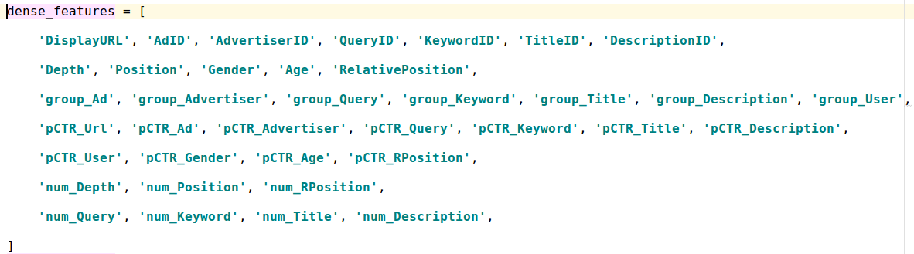
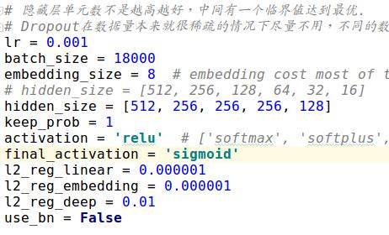
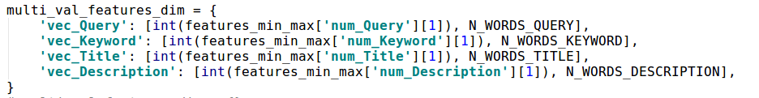
Result
0.7874
Notes:
# get the statistics from original data
python feature_statistic.py
# get the min and max value for normalizing dense features
python features_min_max.py
# construct the mapping for one-hot encoding
python construct_mapping_fn.py
# compute the dimension of sparse features
python count_features_fn.py
# compute the IDF of each token
python tokens_vector.py
# get the sum of IDF for each token
python sum_idf.py
# construct the vector to represent each token
python construct_tokens_vectors.py

Slide 12

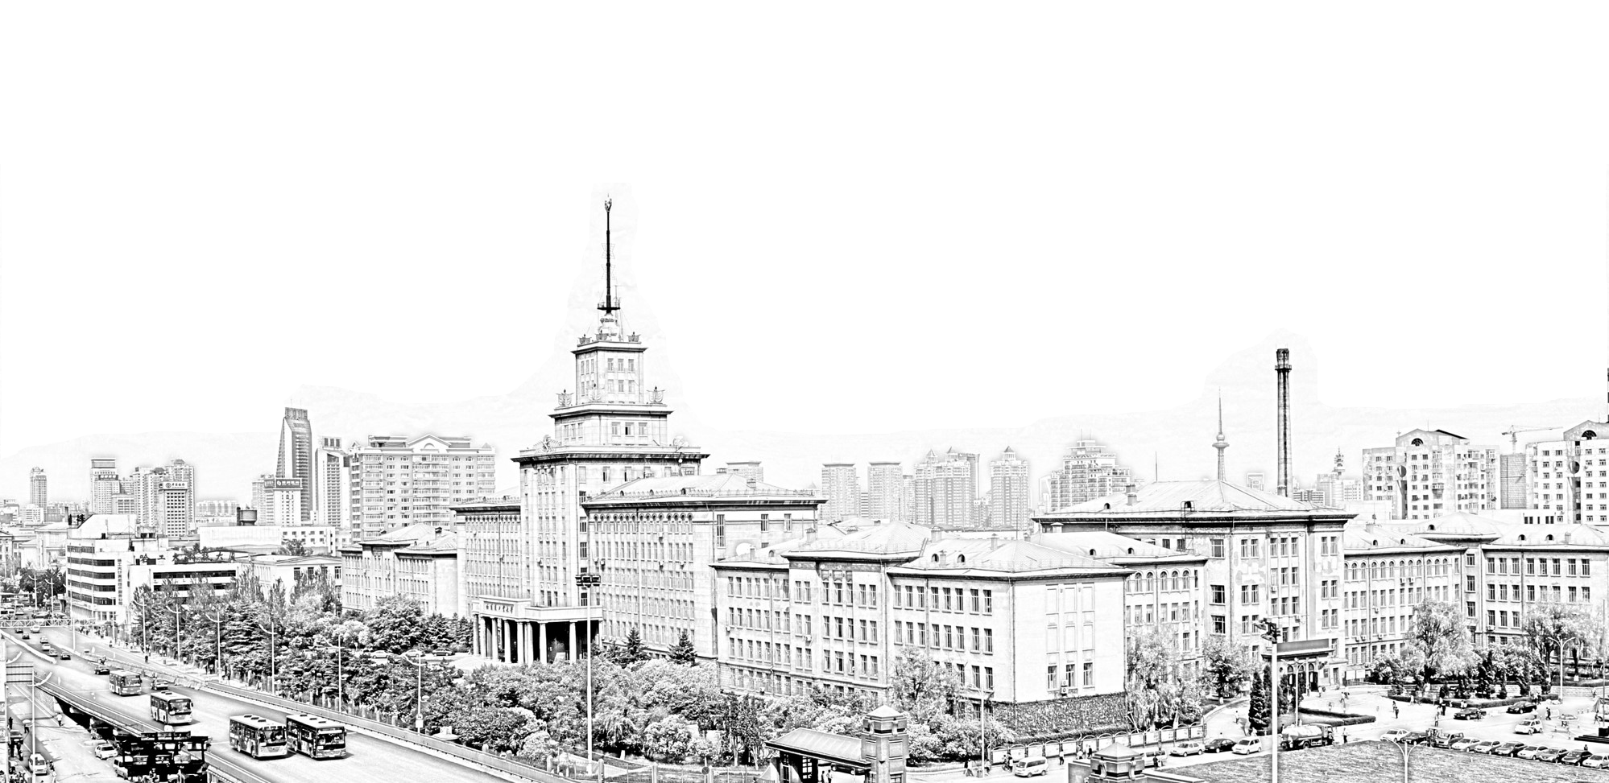
敬请老师批评指正

